Slide 1
Biostats Boot Camp: Session 2
Aditya Biswas and F. Perry Wilson

Slide 2
Today
Exploratory Data Analysis & Descriptive Statistics
Introduction to Probability & Simulation

Slide 3
Types of Data – Modeling Perspective
Continuous
Normal vs. Non-Normal
Count
Ordinal
Binary/Categorical

Slide 4
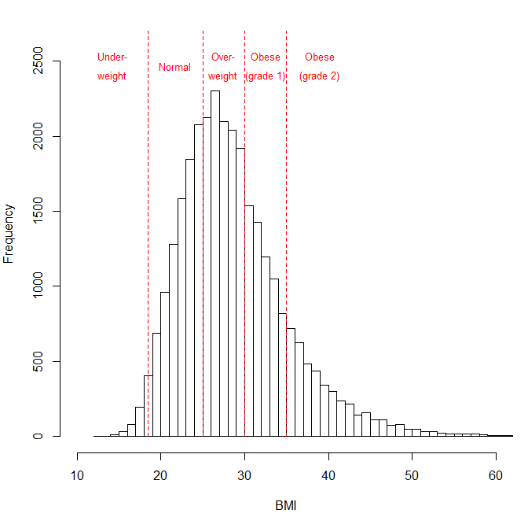
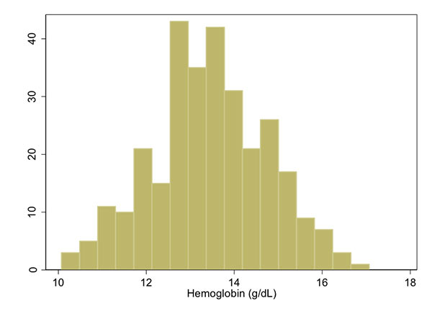
Types of Continuous Data in Medicine
Laboratory Values
Demographics

Slide 5
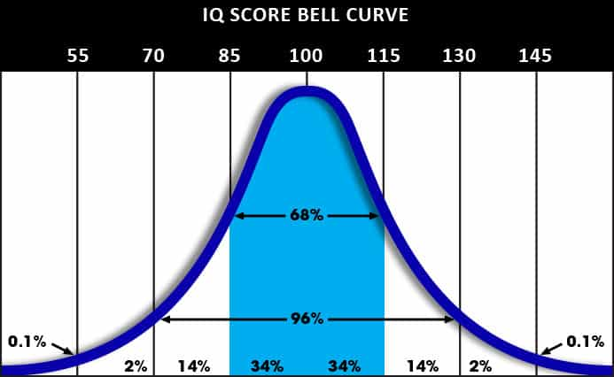
What is Normal?

Slide 6
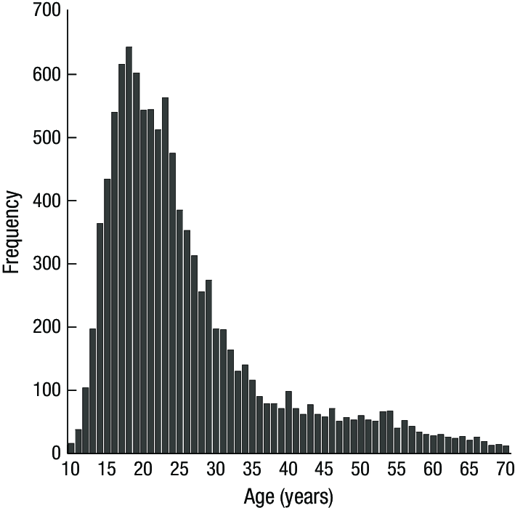
Continuous, Non-Normal Data

Slide 7
Continuous Data: Rank-Based Summaries
Histograms
5-Number Summary
0th percentile (sample min)
25th percentile
50th percentile (sample median)
75th percentile
100th percentile (sample max)
Sample mins and maxes useful for finding data errors

Slide 8
Continuous Data: Location & Shape Summaries
Measures of Central Tendency
Sample Mean
Sample Median
Measures of Dispersion
Sample Standard deviation
Sample Inter-quartile range
Measures of Asymmetry
Sample Skewness

Slide 9
Exercise #1
Produce a five-number summary of creatinine_max. What is the mean? What is the Median?
Create a histogram of creatinine_max. Is it visually skewed in either direction?

Slide 10
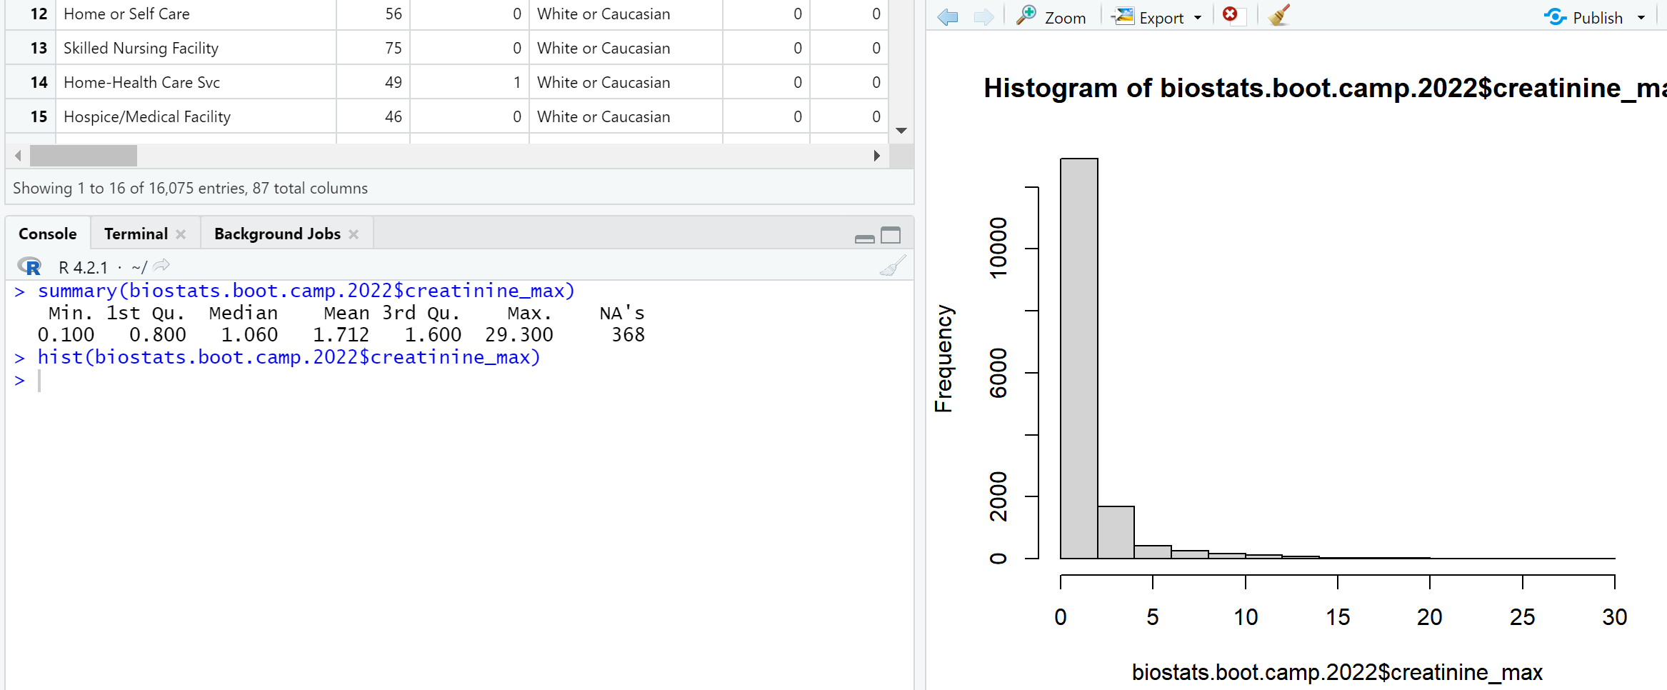

Slide 11
Exercise #2
What is the standard deviation and IQR of creatinine_max in females?
Males?

Slide 12
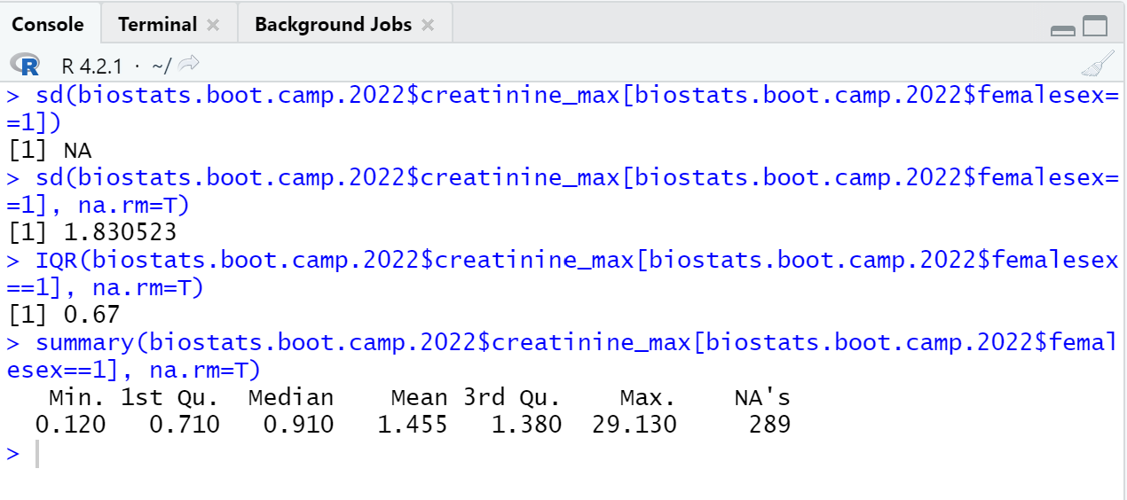
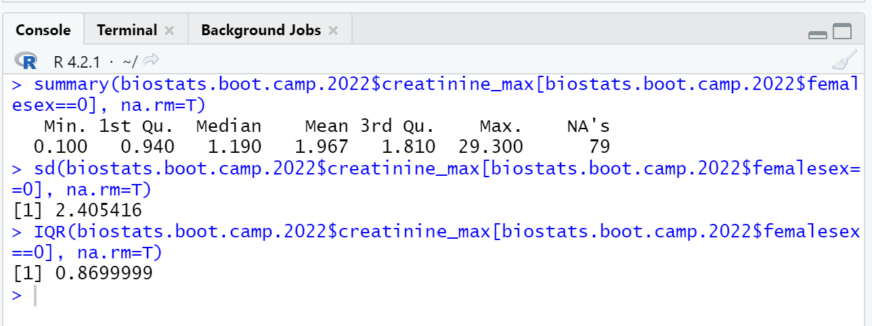

Slide 13
Continuous Data: Subgroup Comparison
Boxplots / Stacked Histograms
Differences in Centrality or Dispersion

Slide 14
Exercise #3
Create a box plot that compares creatinine_max between females and males
Would it help to remove the outliers? (Use outline=F)

Slide 15
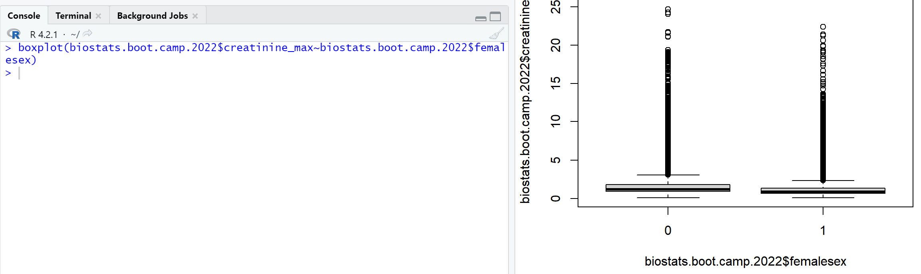
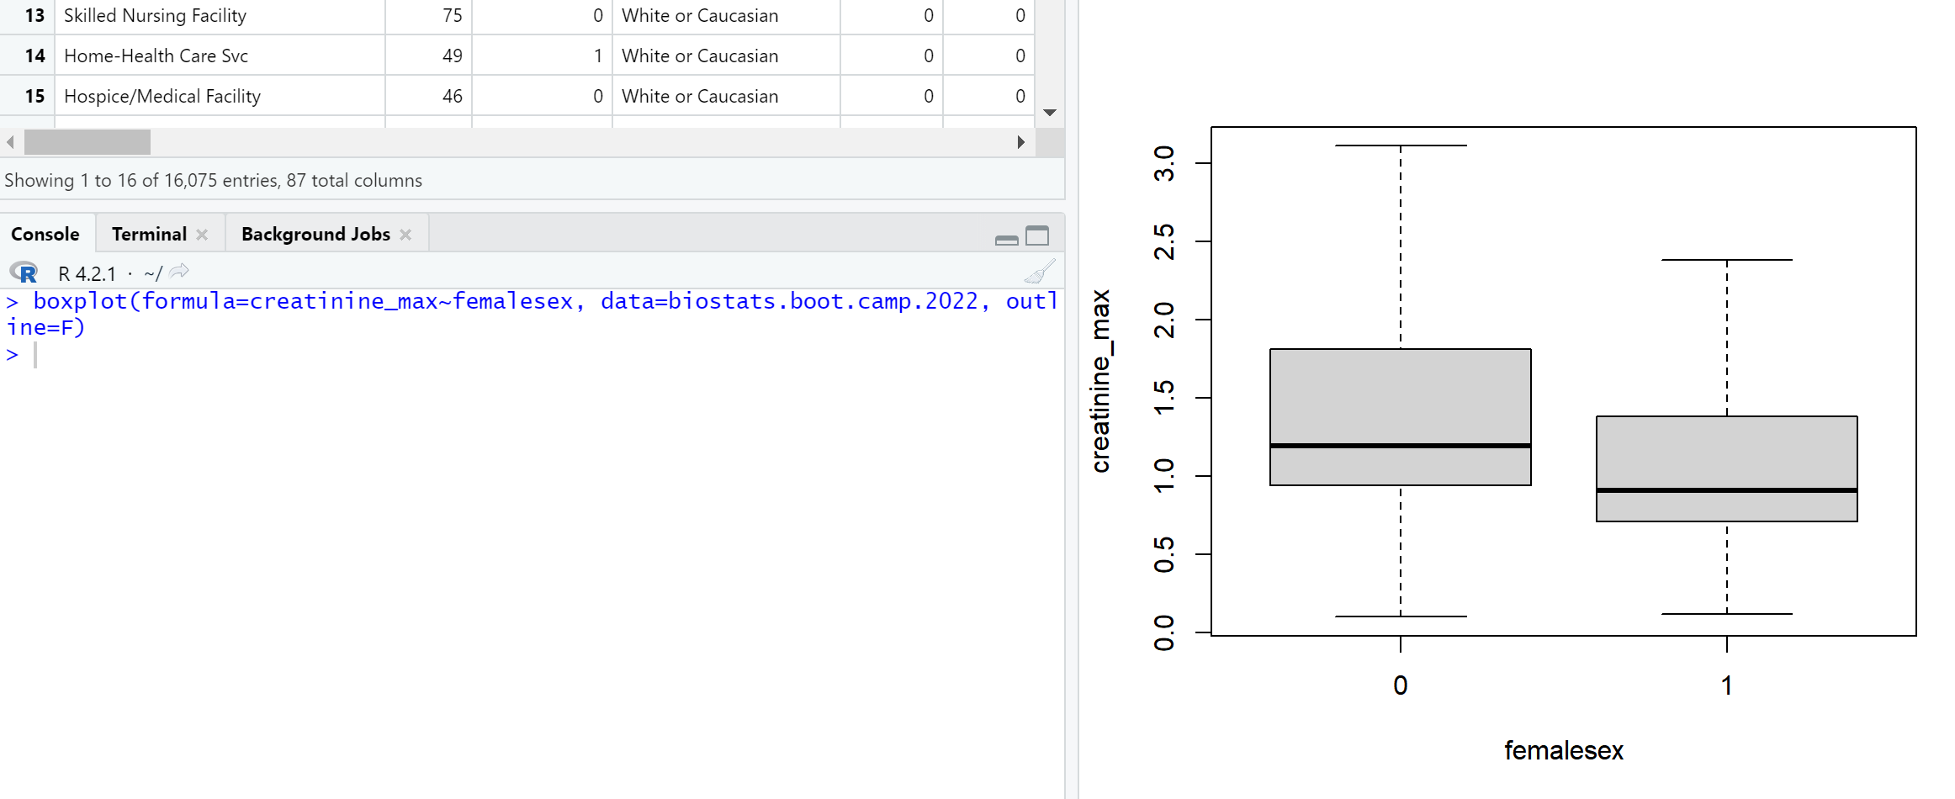

Slide 16
Continuous Data: Association
Scatter plots
Sample Correlation

Slide 17
Exercise #4
Create a scatterplot comparing ast_max and alt_max. What do you notice?
What is the Pearson correlation coefficient?

Slide 18
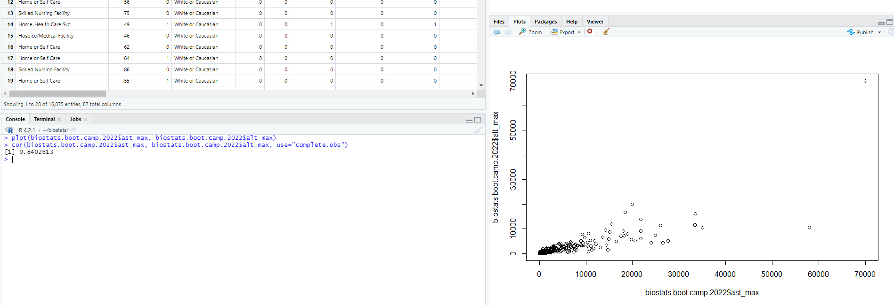

Slide 19
Binary/Categorical Data:
Count, Proportion (or percent)
Sample Mode

Slide 20
Exercise #5
Create a new variable called ckd which takes a value of 1 when the creatinine_max is greater than 1.5 in males or greater than 1.3 in females, and 0 if that is not true
What percent of individuals in the dataset have CKD (by this admittedly bad definition)
(Hint) - you may need to make several "intermediate" variables to get this to work

Slide 21
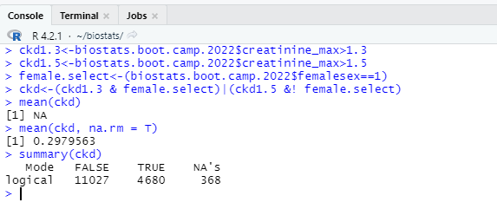

Slide 22
Binary/Categorical Data: Association
Grouped Bar Charts
Count Tables
Proportion Tables

Slide 23
Exercise #6
What proportion of individuals died during their hospitalization?
What proportion of female individuals died during their hospitalization?
Male individuals?

Slide 24
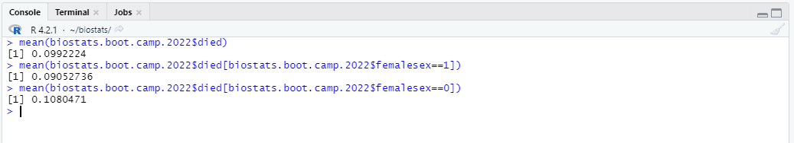

Slide 25
Binary/Categorical Data: Association
Risk Difference
Relative Risk
Odds Ratio

Slide 26
Estimates of difference, men vs. women and death
Risk difference = 10.8% - 9.1% = 1.7%
Relative risk = 10.8%/9.1% = 1.19
Odds of death men = 0.108/(1-0.108) = 0.121
Odds of death women= 0.091/(1-0.091) = 0.10
Odds ratio = 0.121/0.10 = 1.21

Slide 27
In Class Assignment:
Create Table 1
:
 | died==0 | died==1
N | 14480 | 1595
Age (IQR) | 61 (45 – 75) | 78 (66 – 86)
Creatinine (IQR) | 1.01 (0.80 – 1.43) | 2.1 (1.3 – 3.86)
AST_max (IQR) | 48 (32 – 80) | 91 (51 – 204)
ALT_max (IQR) | 40 (23 – 78) | 51 (28 – 130)
Female Sex (%) | 7364 (50.9%) | 733 (46.0%)

Slide 28
In Class Assignment:
Create Table 1
:
 | died==0 | died==1
N
Age (IQR)
Creatinine (IQR)
AST_max (IQR)
ALT_max (IQR)
Female Sex (%)

Slide 29
Switching Gears – Why study probability?
Theoretical and idealized models allow us to derive mathematically precise conclusions
The goal of Statistics is to connect the data we observe to some theoretical and idealized probability model
If we succeed, we can get those mathematically precise conclusions.
Death as a biased coin flip
"All models are wrong, but some are useful." - George Box
To interpret and use statistics correctly, you must understand the probability models they rely on!

Slide 30
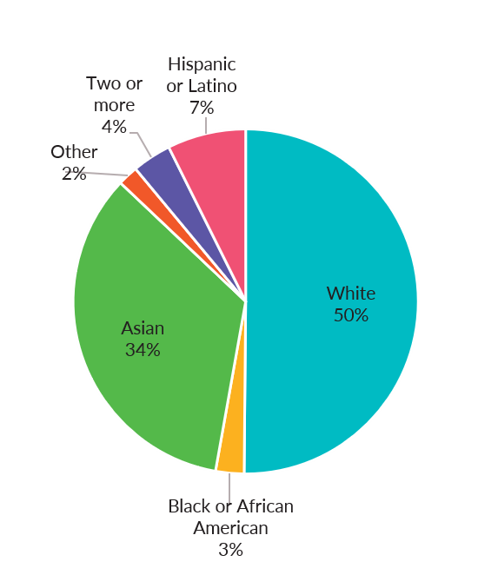
Probability Distributions
Specifies
All potential realizations of data you could possibly see under infinite data
Their associated probabilities
Probabilities must sum to 1

Slide 31
Randomness & Sampling
A philosophical aside
Aleatoric vs epistemic uncertainty
Sample from a distribution - a realization of a concrete value
Frequentist Interpretation of Probability
Under a large number of samples, the estimated proportions should match the theoretical probabilities

Slide 32
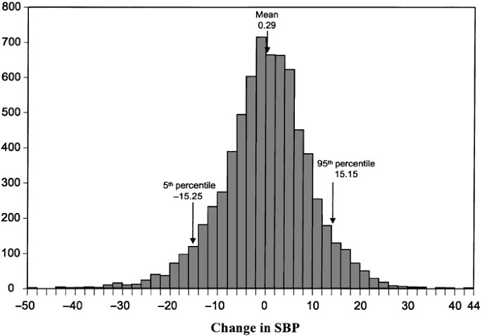
Exploratory Techniques estimate Distributions
Infinite Population
True Proportions
Histograms with infinitely narrow bins
Finite Sample
Sample Proportions
Histograms

Slide 33
Summaries of a Probability Distribution
Measures of Central Tendency
Mean, Median, Mode
Measures of Dispersion
Standard Deviation, IQR
Tail Probabilities
How likely is it that a patient is admitted with a creatinine > 4?

Slide 34
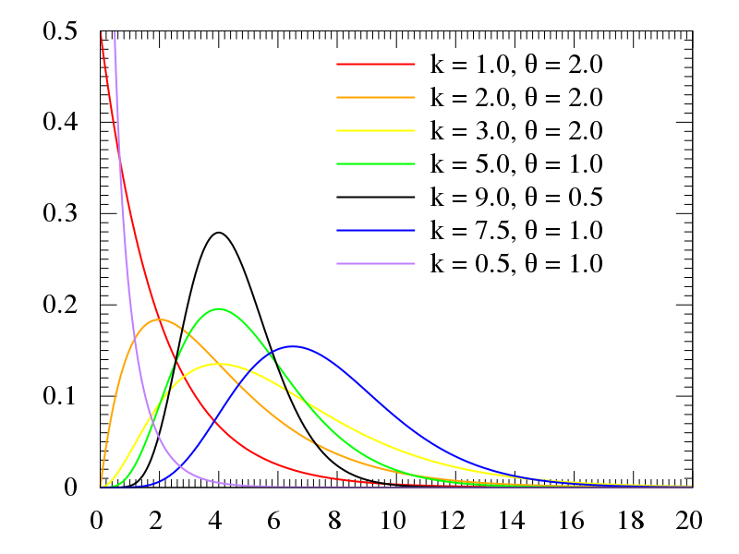
Named Families of Distributions
Parameters control a distribution's
Location
Shape

Slide 35
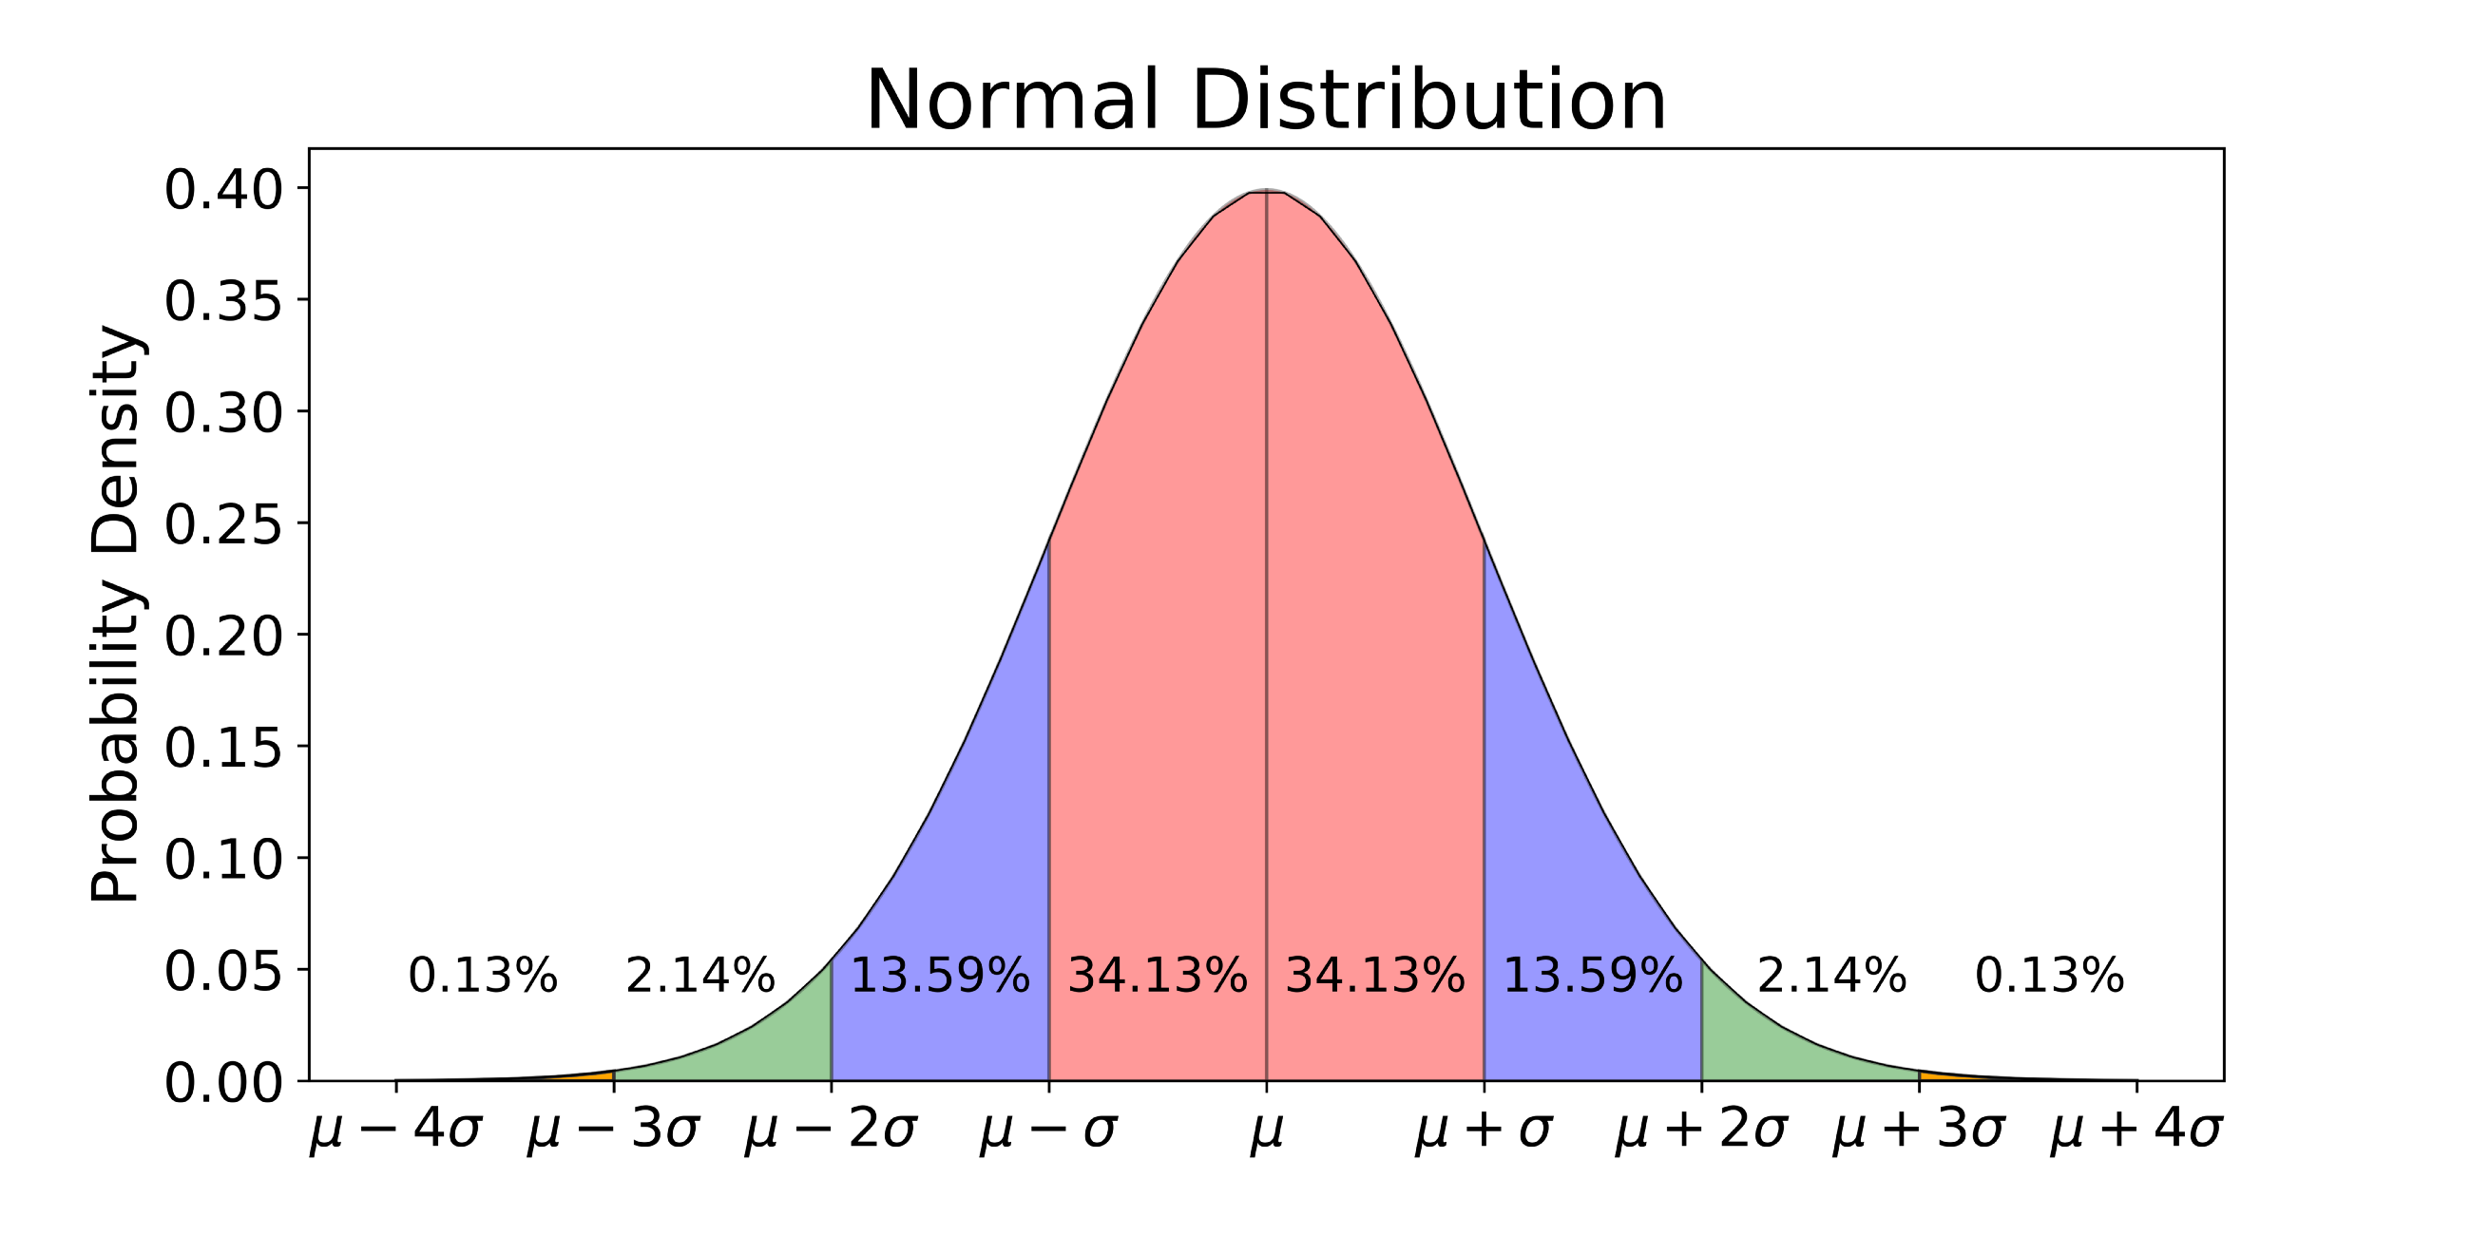
The Normal Family
The Normal Distribution
Possible Values: Any number
Parameter: Mean
Parameter: Standard Deviation

Slide 36
Exercise #
Generate a 50 random numbers from a normal distribution with mean 100 and standard deviation 15. Plot them in a histogram.
Repeat this procedure. Do your plots look different? Why might you expect this behavior?

Slide 37
Exercise #
Check the distributions of sodium_max, temp_max, glucose_max. Which (if any) appear to be normally distributed?

Slide 38
The Binomial Family
Bernoulli Distribution
Values: 0/1 (e.g. Tails/Heads)
Parameter: probability of a 1 (or Heads)
Binomial Distribution
Possible Values: The number of 1's (or Heads) out of a fixed number of Bernoulli Experiments
Parameter: probability of 1 in each Bernoulli Experiment
Parameter: number of Bernoulli experiments
For a binary column in a dataset, its sum is a single sample from a member of this distribution

Slide 39
Exercise
Simulate 100 random flips of a fair coin (ie 50% chance of getting heads on any given flip) and record how many heads you saw

Slide 40
The Poisson Family
Values: Non-Negative Integers (e.g. count of outcomes – like hospitalizations)
Parameter: mean count
Unique property in that mean = Variance

Slide 41
Statistical Independence
Does knowing one variable help you predict another one?
If the answer is no, then the variables are statistically independent
Empirically, scatterplot should look like a trend-less blob

Slide 42
So you want to make your own study?
Pick a variable or a pair of variables you'd like to study
Imagine you have infinite data
i.e. you have access to their true distributions

Slide 43
Targets for Your Study
Summaries of a single distribution
Mean
Variance
Tail Probabilities
Summaries of two distributions
Difference in Means
Correlation
True value of target is unknown
Discovering this value should have some sort of clinical significance

Slide 44
Create a Statistic
Its purpose is to estimate your target
Usually quite straightforward to create sample versions of targets

Slide 45
The Distribution of a Statistic
A statistic is any single-number output from doing mathematical operations on your dataset
Sample median
Difference in sample means
Only 1 dataset
Accordingly, you gather only 1 statistic
But what if you collected 100 datasets? What about 1 million? Infinite?
Every statistic has a theoretical distribution
The statistic from our dataset is just one sample from this distribution
To study our statistic, we must contextualize it amongst all the numbers we could have possibly got and their associated probabilities/frequencies

Slide 46
How to study infinitely many datasets?
Hint: we need to specify a probability model
Will I need to actually do this myself? Will I need to do math?
Relax – statisticians have already figured this out in very general ways. We'll just need to call R functions.
However, you should understand the big picture of what's mathematically happening

Slide 47
Putting it all Together
Pick some variables you want to study
Understand that some underlying distributions exist which characterize them, even though we might not know what these are
Choose some characteristics of these distributions as your target for analysis
e.g.) the difference in mean cholesterol between diabetics and non-diabetics
Create a statistic that estimates this target
e.g.) the difference in sample means of cholesterol btw the groups
Figure out what the distribution of this statistic might be if we had infinitely many datasets
Use this to contextualize and interpret your study's statistic

